Slide 1
ME759 High Performance Computing for Applications in Engineering [Spring 2020]
Lecture 21
03/11/2020
Dan Negrut, 2020 ME759 UW-Madison

Slide 2
The quote the day
“If with a pure mind a person speaks or acts, happiness follows them like a never-departing shadow.”
-- Siddhartha Gautama, The Buddha [563 BC -- 483 BC]

Slide 3
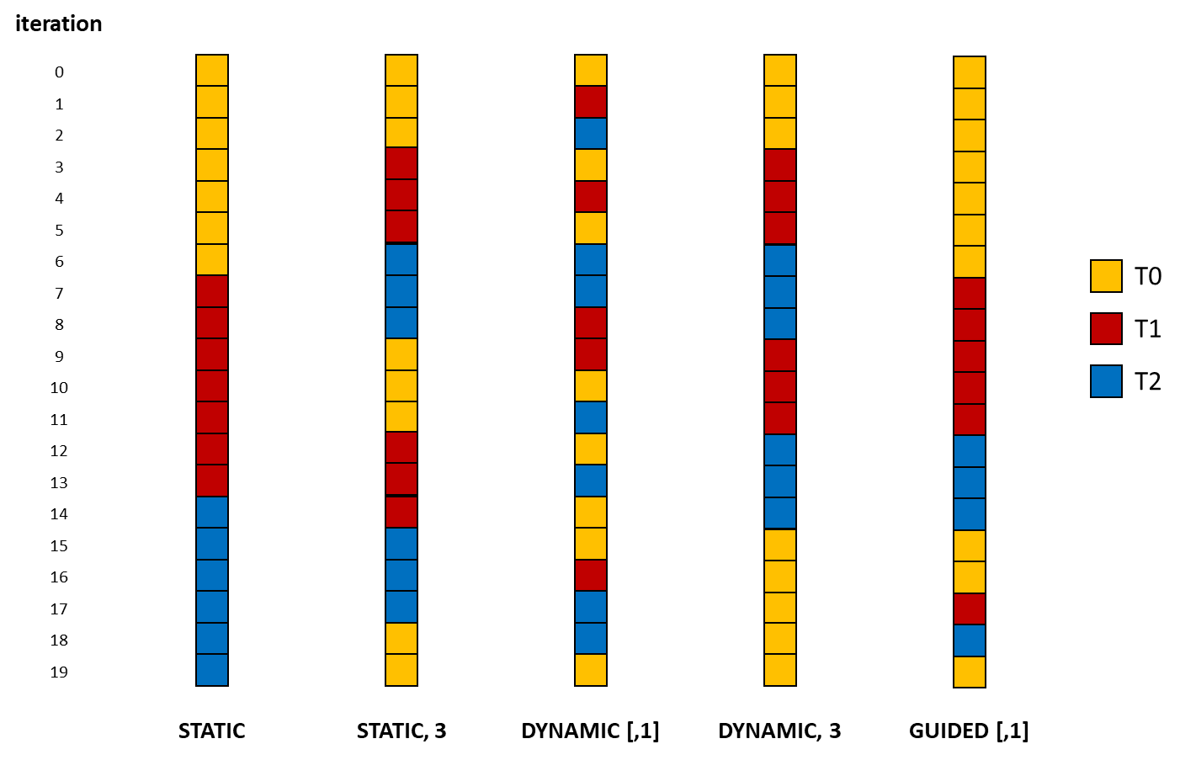
Before we get going…
Last time:
OpenMP generalities
Work-sharing constructs in OpenMP
Today:
Further disucssion of default projects
Tasks, wrap up
Other tidbits:
ME759 Exam: April 15, at 7:15 PM, in 1106ME
Review: Tu, April 14, at 7:00 PM, in Canvas

Slide 4
ME759 Final Project aspects

Slide 5
Final Project Proposals
Proposal Issues:
Two pages long (shorter, if it makes sense).
PDF file to be uploaded in folder FinalProjectProposal
Due on 03/27 at 9 pm
Proposal doc template available here. You must use this template document
Simply populate the fields in there
Template use: Everybody stays on the same page (actually, two pages)
I will try to provide feedback by April 3
This will give you a month to work on the Final Project

Slide 6
Final Project, good to know
Project can be individual or team-based
Teams can have up to three students
Multi-student proposals: need to spell out who does what
Each student submits project proposal, intermediate progress, and final project docs
The docs can be clones, it’s ok

Slide 7
Things to touch on in your Project Proposal document
Project Title: state the title
Link to git repo for project: this is what will be cloned to check your work upon delivery
Problem statement: explain in clear terms what you want to do.
Motivation/Rationale: explain why you chose to work on this project
Explain how you contemplate going about it: indicate if you’ll use GPU/OpenMP/MPI parallel computing, what libraries, etc. Indicate what algorithms/approaches you are considering
ME759 aspects the proposed work draws on: bulleted list, be brief
How you will demonstrate what you accomplished: particularly important if what you do is a small piece of a bigger project that you will continue to pursue after wrapping up ME759.
Team member[s]: Name + email + home department + advisor (if one exists).
If more students, also indicate each student’s anticipated role.
Deliverables: what you expect to deliver on May 6 at 7:45 am
Milestones: indicate what will be accomplished by April 22 milestone
Other remarks: say here anything else that you think Dan should be aware of

Slide 8
Final Project Tied to Your Research
OK to propose a small part of a big undertaking that would be too large to accomplish within one month
This is fine as long as
Project proposed represents a step towards something that is ambitious
You structure the Final Project so that progress can be measured/demonstrated
IMPORTANT: Your score will reflect how well you accomplish what’s spelled out in Project Proposal, not the big task that can’t be done in one month

Slide 9
10/23/2014 Email – From Todd T. [former 759 Student, Spring 2012]
“Hi Dan and Andrew,
Hope time finds you well! Recall my ME964 project to add first-class CUDA discovery, scheduling, management into HTCondor? Well, at long last, earlier this year it all got released into the mainstream stable version of HTCondor, announced at HTCondor Week 2014 back in May, and pushed into all the various distros (Debian, Fedora, etc). It is being used on big clusters in industry and academia. Long ago we talked about telling Nvidia about this, and giving credit to this happening as a 'success story' for nvidia's support of SBEL as a center of excellence…”

Slide 10
Example, 2012 Final Project: GPU Scheduling on a Cluster
Spring 2012 Final Project
Tied to the Condor Project
Condor: started at UW-Madison by Professor Miron Livny (in 1985)
Two students working for Professor Livny took 759 in back in the day
Places where GPU Scheduler used for science today
Large Hadron Collider (LHC) – CERN, Switzerland
Hadron collider: 2013 Nobel Prize in Physics for Higgs boson
Laser Interferometer Gravitational-wave Observatory (Ligo) – WA / LA, USA
Space/Time wrinkle, 2017 Nobel Prize in Physics
Ice Cube, Antarctica
South Pole Neutrino Observer, run by UW-Madison
Last year: $35 million NSF to UW-Madison

Slide 11
Words of wisdom
If you are stress-adverse, propose something that is clearly doable
Keep in mind that all you have about a month
Factor in exams, final reports, etc. for other classes. You have less time than you think you do
My advice (doesn’t apply to all):
Tie the Final Project to your research
If no research topic yet, tie it to something that you are curious about
Be ambitious, yet propose something that demonstrates quantifiable progress
Failing is totally ok, if it comes despite hard work

Slide 12
Milestones and deliverables
Final Project proposal (PDF doc) – March 27, 9 pm
Canvas folder: FinalProjectProposal
Final Project progress report, a one pager (PDF doc) – April 23, 9 pm
Canvas folder: FinalProjectIntermediate
Final Project report (PDF doc) – May 6, 7:45 am
Canvas folder: FinalProject
Code in your git repo – May 6, 7:45 am
Used to verify results reported in Final Project document

Slide 13
Final Projects suggestions – in case you can’t come up with a topic
Two tiers
Tier one: UW-Madison brewed, they are easier (four of them)
Tier two: Intel brewed, they are tough (four of them)

Slide 14
Tier 1, Option 1: Large code for physics-based simulation
For more details, see here.
Topic related to code developed by former ME759 student (became his PhD thesis)
Use case scenario put together by person working with the European Space Agency (Cecily Sunday)
Tasks:
Profile a large code
Look at how’s parallelized
Suggest avenues for improving speed
Implement some of these changes to improve execution speed (which is really low, right now)

Slide 15
Tier 1, Option 2: Image processing
For more details, see here
Issues of interest:
Finding edges in a pic
Image stitching

Slide 16

Tier 1, Option 3 : Solving $Ax=b$
For more details, see here
Task: Implement a parallel solution to solving $Ax=b$
There are two flavors that you might consider
Iterative solvers
Direct solvers
To make it even more interesting:
Dense problems
Sparse problems

Slide 17
Tier 1, Option 4: Break password through brute force
For more details, see here.
Task: write a parallel code that attempts to break a password through brute force
Important: your implementation should only be used for academic purposes and should never be used to engage in any illegal or otherwise dubious activity of a nefarious nature

Slide 18
Tier 2: Intel-suggested Final Project topics
Coming from group at Intel made up of 13 compiler engineers working on optimizing machine learning workloads on various hardware platforms
Working w/ specialized hardware groups to ensure fast execution of inference and training workloads through hardware-software co-design
See https://github.com/plaidml/plaidml
Currently working closely with the LLVM community and the MLIR group at Google to contribute to the affine dialect in MLIR
See https://mlir.llvm.org/docs/Dialects/AffineOps
Researching repurposing machine learning optimization techniques for scientific workloads

Slide 19
Default Final Project topics suggested by Intel group
Topic | Description | Helpful References
LLVM Optimization Analysis | Analyze LLVM Optimization Passes using established benchmarks | https://rd.springer.com/content/pdf/10.1007%2F978-3-319-91479-4_23.pdf
Survey and Analysis of Tensor Compilers | Analyze and benchmark tensor compilers for ML across various HW OR Investigate the results produced in 2. | https://arxiv.org/abs/2002.03794 http://www.eecs.harvard.edu/~htk/publication/2019-mapl-tillet-kung-cox.pdf
High performance GEMM library for a GPU | Utilizing the techniques described in papers 1 and 2 on the right And the MLIR's new support for affine.parallel: (see 3 on the right) Implement a high performance GEMM library for a GPU | https://arxiv.org/abs/2003.00532 https://paperswithcode.com/paper/stripe-tensor-compilation-via-the-nested https://mlir.llvm.org/docs/Dialects/AffineOps/#affineparallel-affineparallelop
Distributed SLIDE | Reproduce the results presented for SLIDE in 1. Using the code provided on github (2) Implement a distributed version of SLIDE. | https://arxiv.org/pdf/1903.03129.pdf https://github.com/keroro824/HashingDeepLearning/tree/master/SLIDE

Slide 20
Intel related Final Projects
If you want to, the Intel folks will read your Final Project
You’ll have to explicitly indicate that you are ok with me sharing your Final Project with them
There will be a box to check in both the proposal and final docs
This is hard stuff, very challenging
Work on it if you want to get a conversation going with this Intel group

Slide 21
Back to OpenMP program

Slide 22
OpenMP Tasks – Motivation [3/3]
Use single nowait inside a parallel region
Why we shouldn’t settle for this:
Relatively high cost of the single construct
Each thread needs to traverse the entire list and determine if another thread has already processed that element
Ensuring that no other thread has processed a list element is not trivial at all
The code ensuring this is not shown here and would have to be inside the process(p) function call
#pragma omp parallel private(p)
{
p = listhead;
while (p != listend) {
#pragma omp single nowait
process(p);
p = next(p);
}
[IEEE TPDS 20(3), pp. 404-418, 2009]→

Slide 23
One-Slide Side-Trip: When Compiler Doesn’t Speak OpenMP
Imagine your compiler doesn’t speak OpenMP
Previous piece of code: is like ignoring all the pragmas
Ignoring pragmas: You’d get your sequential implementation that you used to have before you decorated the code w/ OpenMP directives
#pragma omp parallel private(p)
{
p = listhead;
while (p != listend) {
#pragma omp single nowait
process(p);
p = next(p);
}

Slide 24
The task Concept in OpenMP
Happens fast!
thread
Task generator
…
thread
thread
thread
Execute tasks
[Ruud van der Pas]→

Slide 25
Tasks: Who Does What and When?
The developer (you, that is), does this:
Use a pragma to specify where/what the tasks are
Ensure that there are no dependencies (that is, tasks can be executed independently)
The OpenMP runtime system does this:
Generates a new task whenever a thread encounters a task construct
Decide the moment of execution (can be immediate or delayed)
[Ruud van der Pas]→

Slide 26
What Are Tasks? How Do They Work?
Tasks are independent units of work
One or more threads assigned to generate tasks
The OpenMP threads pick up & execute the “posted” tasks
Tasks might be executed immediately or might be deferred
The OS & runtime decide which of the above
Decision transparent to the user
Time
Serial
Tasks
[IOMPP]→

Slide 27
What Are Tasks? [Preamble]
Three concepts important in the context of tasks
Code to execute
The literal code in your program enclosed by the task directive
Data environment
The shared & private data manipulated by the task
Internal control variables (ICV)
Thread scheduling and environment variables

Slide 28
What Are Tasks? [The specifics…]
More formal definition:
A task is a specific instance/combo of executable code along w/ its data environment and ICV
This “instance/combo” is generated when a thread encounters a task construct
In other words, there are three activities: (1) packaging, (2) posting the job, and (3) execution of the jobs
A thread packages a new instance of a task; i.e., its code & data & ICVs
This “combo” is placed in a queue of “things to do”
Some thread in the team executes the task at some later time

Slide 29
The task Directive
A team of threads is created at the omp parallel construct
A single thread is chosen to execute the while loop – let’s call this thread “L”
Thread L runs the while loop, creates tasks, and fetches next pointers
Each time L crosses the omp task construct it generates a new task and has a thread assigned to it
Each task run by one thread
#pragma omp parallel //threads are ready to go now
{
#pragma omp single nowait
{
node *p = head_of_list;
while(p != end_of_list) {
#pragma omp task firstprivate(p)
process(p);
p = p->next;
}
}
}
All tasks complete at the barrier at the end of the parallel region’s construct
Each task has its own stack space that will be destroyed when the task is completed
[IOMPP]→

Slide 30
#include <omp.h>
#include <list>
#include <iostream>
#include <math.h>
typedef std::list<double> LISTDBL;
void doSomething(LISTDBL::iterator& itr) { *itr *= 2; }
int main() {
LISTDBL test;
LISTDBL::iterator it;
for (int i = 0; i < 4; i++)
for (int j = 0; j < 8; j++)
test.push_back(pow(10.0, i + 1) + j);
for (it = test.begin(); it != test.end(); ++it) printf("%g\n", *it);
it = test.begin();
#pragma omp parallel num_threads(8)
{
#pragma omp single nowait
{
while (it != test.end()) {
#pragma omp task firstprivate(it)
{
doSomething(it);
} // end omp task
it++;
}
printf("...master done\n");
} // end omp single
} // end omp parallel
for (it = test.begin(); it != test.end(); ++it) printf("%g\n", *it);
return 0;
}

Slide 31
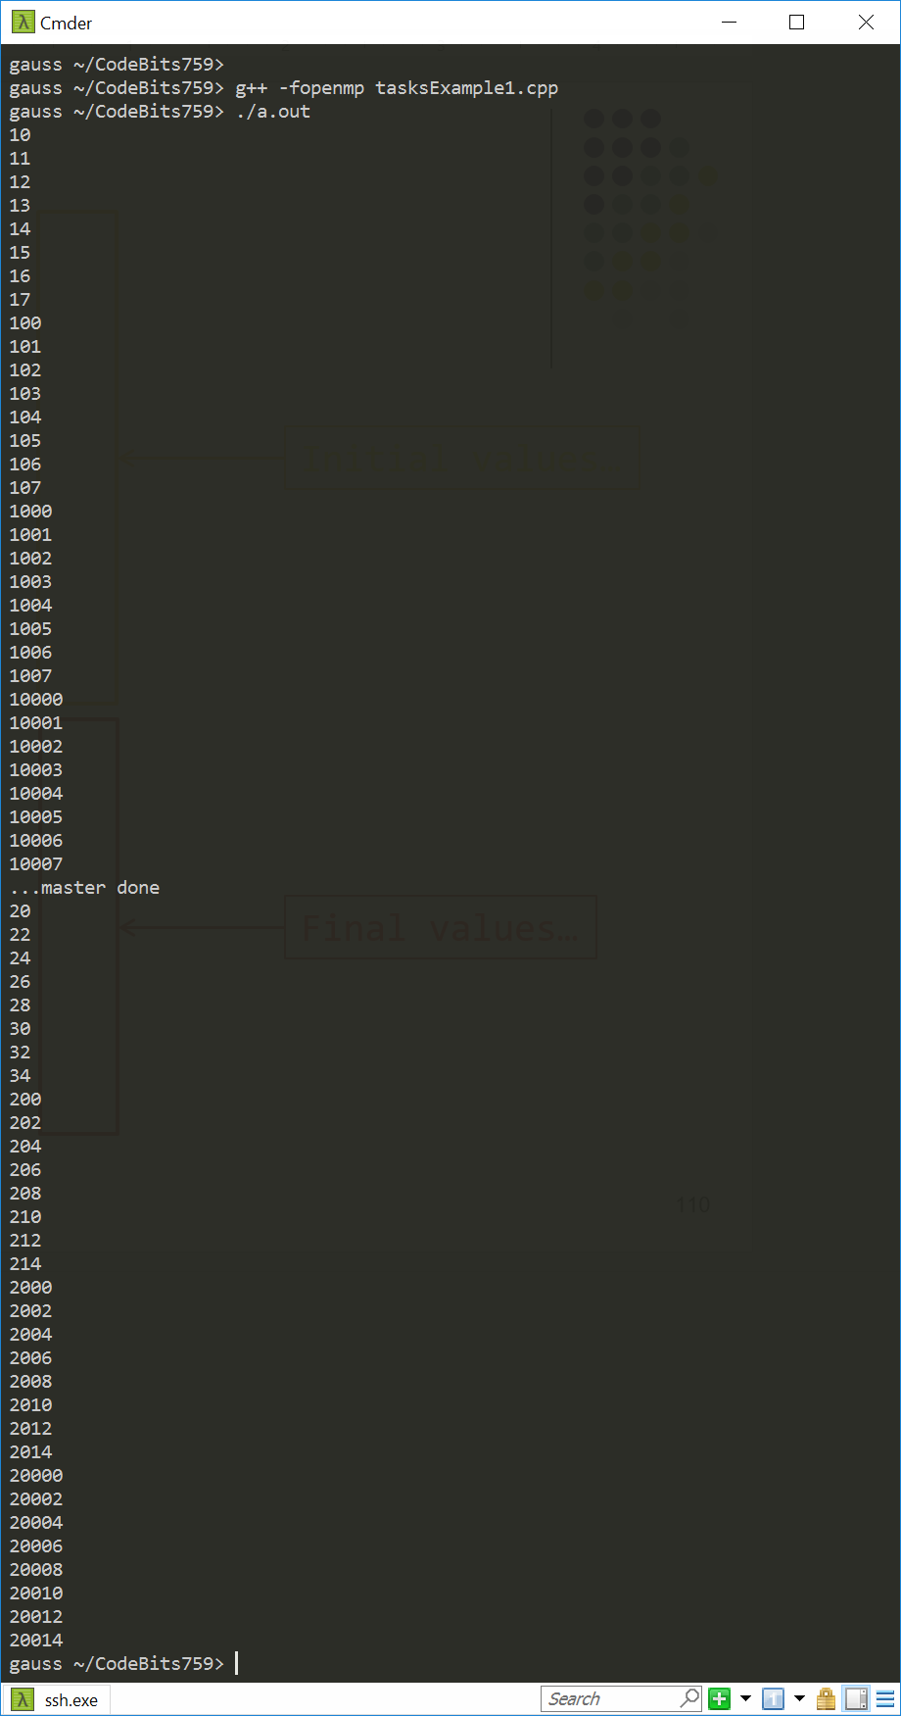
Initial values…
Final values…

Slide 32
Tasks: Synchronization Issues
Setup:
Assume Task B specifically relies on completion of Task A
You need to be in a position to guarantee completion of Task A before invoking the execution of Task B
Tasks are guaranteed to be complete at thread or task barriers:
At the directive: #pragma omp barrier
At the directive: #pragma omp taskwait
[IOMPP]→

Slide 33
Task Completion Example
Multiple foo tasks created here – one for each thread
#pragma omp parallel
{
#pragma omp task
foo();
#pragma omp barrier
#pragma omp single
{
#pragma omp task
bar();
}
}
All foo tasks guaranteed to be completed here
One bar task created here
bar task guaranteed to be completed here
[IOMPP]→

Slide 34
Comments: section vs. task
sections have a “static” attribute
Things are mostly settled at compile time
The task OpenMP construct more recent and more sophisticated
Has a “dynamic” attribute: things figured out at run time
A task can encapsulate any block of code
Can handle nested loops and scenarios when the number of jobs is not clear
Big hammer, watch your fingers…

Slide 35
Work Plan, OpenMP
What is OpenMP?
Parallel regions
Work sharing – Parallel tasks
Variable Scoping Issues
Synchronization
Performance issues
Loose ends

Slide 36
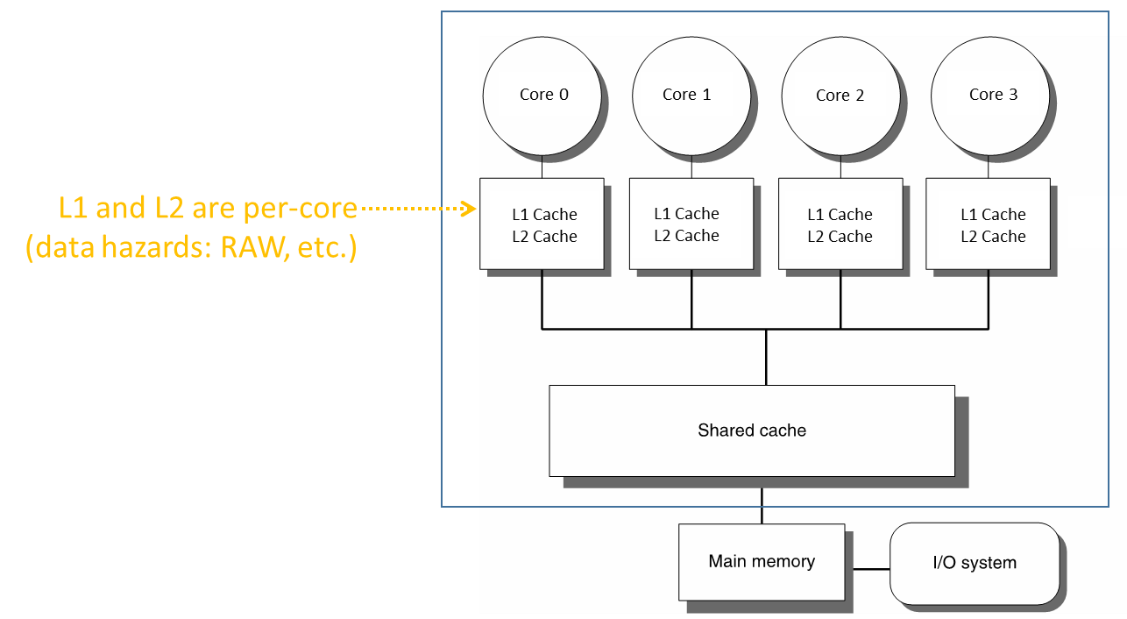
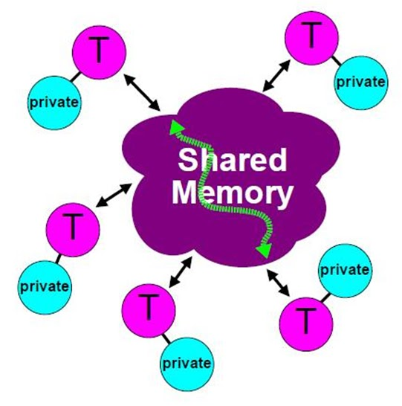
OpenMP Attributes
Parallel execution of multiple tasks via multiple threads
Threads have access to a pool of memory that is shared
Threads can have private data
Not accessible by other threads
When/How data is written/read from memory is transparent to programmer
However, programmer has some control (atomic, flush, etc.)
Synchronization in thread execution is implicit but can be made explicit as well
[CodeProject]→

Slide 37
Variable Scoping Issues in OpenMP
Important question: what is shared and what is not?
That is, what can a thread access, and what cannot it access?
Important why?
If a variable is shared, then you better be aware of that
Parallel computing data hazards, in relation to WAR, RAW, WAW
“Variable scoping in OpenMP”:
Understanding whether a variable that a thread works with is private or shared

Slide 38
Variable Scoping Issues in OpenMP – What is shared?
OpenMP uses a shared-memory programming model
Shared variable - a variable that can be read or written by multiple threads
Private variable – a variable whose value is only visible to a thread (for read/write)

Slide 39
Variable Scoping Issues in OpenMP – What is shared?
Basic rule:
Any variable declared prior to a parallel region is shared in that parallel region
That is, it is available for read/write to all parallel threads of the parallel region
Other examples of variables being shared among threads
Global variables
File scope variables
Namespace scope variables
Variables with const-qualified type having no mutable member
static variables which are declared in a scope inside the construct
Note: there’s a shared clause that you can use if you feel like explicitly indicating that a variable is shared

Slide 40
The private Clause
Reproduces for each thread variable[s] declared private in the pragma (see example below)
Consequence: each thread will have a private copy of that variable in the associated parallel region
The value that Thread_1 stores in x is different than value that Thread_2 stores in variable x
NOTE: Private variables are un-initialized; C++ object is default-constructed
void* work(float* c, int N) {
float x, y;
int i;
#pragma omp parallel for private(x,y)
for(i=0; i<N; i++) {
x = a[i]; y = b[i];
c[i] = x + y;
}
}
[IOMPP]→

Slide 41
Data Scoping – What is Private?
Examples of OpenMP variables treated as private by default:
Stack (local) variables in functions called from parallel regions
C/C++: call by copy vs. call by reference
Loop iteration variables
Automatic variables within a statement block
[IOMPP]→

Slide 42
Example [more dwelling on the private concept]: Is “i” shared or private?
curie ~/ME759/OpenMP> g++ firstPrivateP0.cpp -fopenmp
curie ~/ME759/OpenMP> ./a.out
threadID = 0 i = 10
threadID = 2 i = 10
threadID = 1 i = 10
threadID = 3 i = 10
i = 1003
curie ~/ME759/OpenMP> ./a.out
threadID = 3 i = 10
threadID = 0 i = 10
threadID = 2 i = 10
threadID = 1 i = 10
i = 1001
curie ~/ME759/OpenMP> ./a.out
threadID = 0 i = 10
threadID = 3 i = 10
threadID = 1 i = 10
threadID = 2 i = 10
i = 1002
curie ~/ME759/OpenMP> ./a.out
threadID = 0 i = 10
threadID = 3 i = 10
threadID = 1 i = 10
threadID = 2 i = 10
i = 1002
curie ~/ME759/OpenMP> ./a.out
threadID = 0 i = 10
threadID = 3 i = 10
threadID = 2 i = 10
threadID = 1 i = 10
i = 1001
curie ~/ME759/OpenMP>
#include <omp.h>
#include <cstdio>
int main() {
int i = 10;
#pragma omp parallel num_threads(4)
{
int threadID = omp_get_thread_num();
printf("threadID = %d i = %d\n", threadID, i);
i = 1000 + threadID;
}
printf("i = %d\n", i);
return 0;
}

Slide 43
private: somewhat sneaky
#include <stdio.h>
#include <omp.h>
int main(void) {
int i = 10;
#pragma omp parallel num_threads(4) private(i)
{
int threadID = omp_get_thread_num();
printf("threadID = %d: i = %d\n", threadID, i);
i = 1000 + threadID;
}
printf("i = %d\n", i);
return 0;
}
What do we expect each thread to print?
What do we expect the master thread to print at the end?
curie ~/ME759/OpenMP> g++ firstPrivateP1.cpp -fopenmp
curie ~/ME759/OpenMP> ./a.out
threadID = 0 i = 0
threadID = 2 i = 0
threadID = 3 i = 0
threadID = 1 i = 0
i = 10
curie ~/ME759/OpenMP> g++ firstPrivateP1.cpp -Wall -fopenmp
… some stuff here…
firstPrivateP1.cpp:10:11: warning: ‘i’ is used uninitialized in this function [-Wuninitialized]
printf("threadID = %d i = %d\n", threadID, i);
~~~~~~^~~~~~~~~~~~~~~~~~~~~~~~~~~~~~~~~~~~~~~~
firstPrivateP1.cpp:5:7: note: ‘i’ was declared here
int i = 10;
^

Slide 44
private vs. firstprivate
firstprivate
Goes one step beyond where private stops
Specifies that each thread should have its own instance of a variable
Moreover, the variable is initialized using the value of the variable of the same name from the master thread
[IOMPP]→

Slide 45
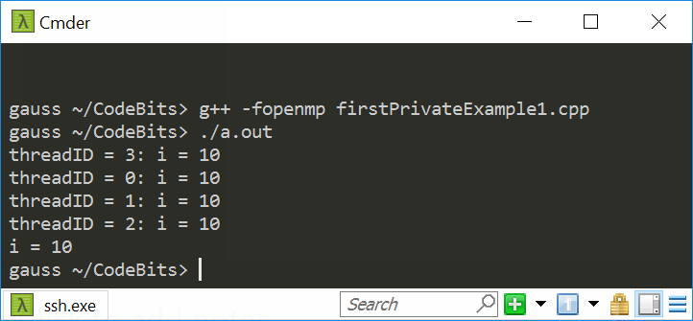
private vs. firstprivate
#include <stdio.h>
#include <omp.h>
int main(void) {
int i = 10;
#pragma omp parallel num_threads(4) firstprivate(i)
{
int threadID = omp_get_thread_num();
printf("threadID = %d: i = %d\n", threadID, i);
i = 1000 + threadID;
}
printf("i = %d\n", i);
return 0;
}
What do we expect each thread to print?
What do we expect the master thread to print at the end?

Slide 46
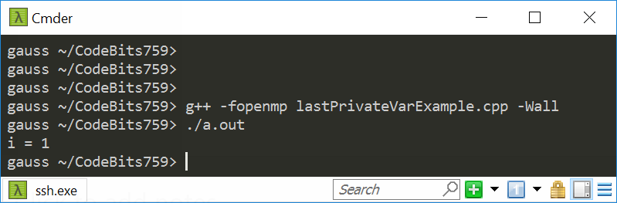
The lastprivate OpenMP directive
The enclosing context's version of the variable is set equal to the private version of whichever thread executes the final iteration of the work-sharing construct (for or section)
What do we expect the master thread to print at the end?
#include <stdio.h>
#include <omp.h>
int main(void) {
int i;
#pragma omp parallel for num_threads(4) schedule(static, 2) lastprivate(i)
for (int j = 0; j < 11; j++) {
i = omp_get_thread_num();
}
printf("i = %d\n", i);
return 0;
}

Slide 47
Harping On Data Scoping
A key tenet of OpenMP: that of data independence between threads
When parallel threads execute parallel regions it is assumed
Data dependencies are inexistent across parallel regions, OR
If data dependencies exist, there will be no race conditions
Since you placed the omp parallel directive in your code, it is your responsibility to make sure that data dependencies do not lead to race conditions
Compilers not smart enough and sometimes can’t identify data dependency between what might look like independent parallel tasks

Slide 48
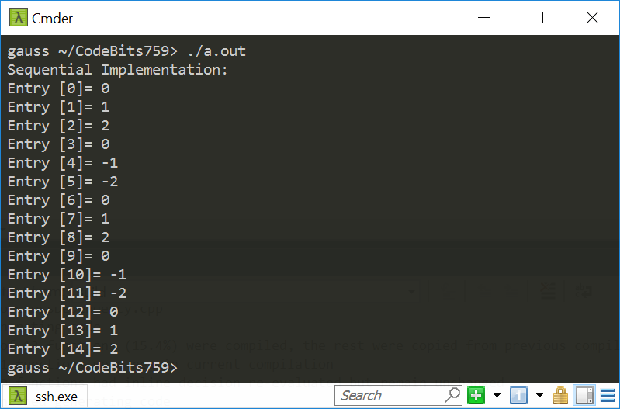
Data Dependency Example [1/5]
#include <omp.h>
#include <stdlib.h>
#include<iostream>
int main()
{
const int N = 15;
int* a = (int*)calloc(N, sizeof(int)); //array a has a bunch of zeroes
//Basic idea: initialize the first "offset" entries of a and then
//populate all the other entries of a based on these first entries
const int offset = 3;
for (int i = 0; i < offset; i++)
a[i] = i;
for (int i = offset; i < N; i++)
a[i] -= a[i - offset];
//print out the content of a
std::cout << "Sequential Implementation:\n";
for (int i = 0; i < N; i++)
std::cout << "Entry [" << i << "]= " << a[i] << std::endl;
return 0;
}

Slide 49
Data Dependency Example [2/5]
#include <omp.h>
#include <stdlib.h>
#include<iostream>
int main()
{
const int N = 15;
int* a = (int*)calloc(N, sizeof(int)); //array a has a bunch of zeroes; N of them.
//Basic idea: initialize the first "offset" entries of a and then
//populate all the other entries of a based on these first entries
const int offset = 3;
for (int i = 0; i < offset; i++)
a[i] = i;
#pragma omp parallel num_threads(2)
{
#pragma omp single
std::cout << "Running w/ this many threads: " << omp_get_num_threads() << std::endl;
#pragma omp for
for (int i = offset; i < N; i++)
a[i] -= a[i - offset];
}
//print out the content of a
for (int i = 0; i < N; i++)
std::cout << "Entry [" << i << "]= " << a[i] << std::endl;
return 0;
}
We’re going to keep changing this value here

Slide 50
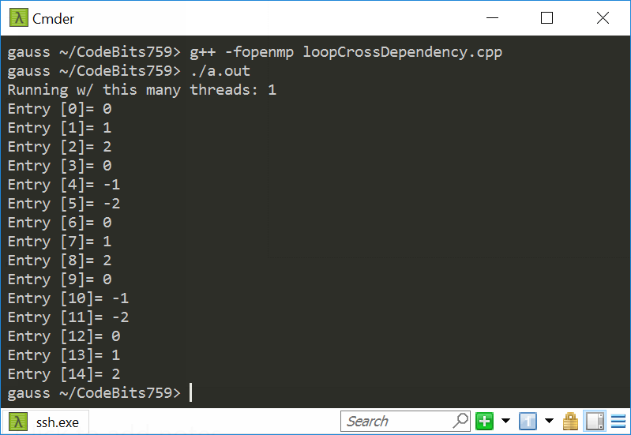
Data Dependency Example: 1 Thread [3/5]
Running OpenMP with one thread is essentially running sequentially

Slide 51
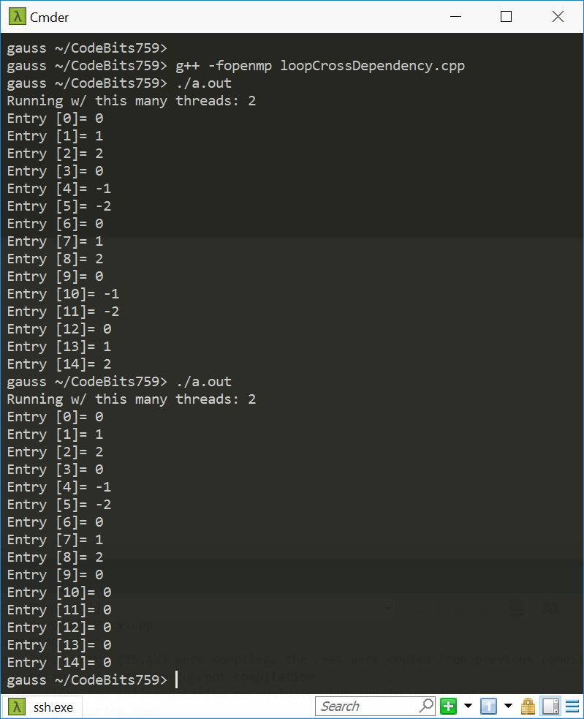
Data Dependency Example: 2 Threads [4/5]

Slide 52

Data Dependency Example: 3 Threads [5/5]

Slide 53
Quiz: what’s shared and what’s not?
float A[10];
main() {
int index[10];
#pragma omp parallel
{
Work(index);
}
printf("%d\n", index[1]);
}
extern float A[10];
void Work(int* index)
{
float temp[10];
static int count;
<...>
}
Assumed to be in another translation unit
A, index, count
A, index, and count are shared by all threads, but temp is local to each thread
A, index, count, temp: which is shared, and which is private?
temp
temp
temp
A, index, count
[IOMPP]→

Slide 54
Data Scoping – Words of Wisdom
When in doubt,
Explicitly indicate who is what
Write a toy example to experiment
OpenMP provides the clause default(none)
In this case, the compiler requires that we specify scope for each variable declared outside the block
Variable declared inside the block are private
Data scoping: a common sources of errors in OpenMP

Slide 55
Work Plan, OpenMP
What is OpenMP?
Parallel regions
Work sharing – Parallel tasks
Variable Scoping Issues
Synchronization
Performance issues
Loose ends

Slide 56
Implicit Barriers
Several OpenMP constructs have implicit barriers
parallel – necessary barrier – cannot be removed
for
single
Unnecessary barriers hurt performance and can be removed with the nowait clause
The nowait clause is applicable to:
for directive
single directive
[IOMPP]→

Slide 57
The barrier Construct
Explicit barrier synchronization
Each thread waits until all threads arrive
Example below assumes that in DoSomework(X,Y) X is an input and Y is the output:
#pragma omp parallel shared(A, B, C)
{
DoSomeWork(A,B); // input is A, output is B
#pragma omp barrier
DoSomeWork(B,C); // input is B, output is C
}
Quick question: how about breaking this into two parallel regions?
[IOMPP]→

Slide 58
The nowait Clause
#pragma omp for nowait
for(…)
{ […] }
#pragma single nowait
{ […] }
Use when threads unnecessarily wait between independent computations
#pragma omp for schedule(static) nowait
for(int i=0; i<n; i++)
a[i] = bigFunc1(i);
#pragma omp for schedule(dynamic,1)
for(int j=0; j<m; j++)
b[j] = bigFunc2(j);
[IOMPP]→

Slide 59
Example, Synchronization Issue: Computing the Dot Product
float dot_prod(float* a, float* b, int N)
{
float sum = 0.0;
#pragma omp parallel for shared(sum)
for(int i=0; i<N; i++) {
sum += a[i] * b[i];
}
return sum;
}
What is wrong here?
[IOMPP]→

Slide 60
Race Condition
Race condition: two or more threads access a shared variable at the same time
Leads to nondeterministic behavior
Both Thread A and Thread B are executing the statement
sum += a[i] * b[i];
See next slides for how things might play out
[IOMPP]→

Slide 61
Race conditions (data hazards) – two possible scenarios
Value of
sum
Thread A
Thread B
Value of
sum
Thread A
Thread B
11.667
11.667
+3.765
+3.765
15.432
11.667
15.432
15.432
+ 3.563
+ 3.563
18.995
15.230
Order of thread execution causes non-deterministic behavior in a data race
[IOMPP]→

Slide 62
Example: Computing the Dot Product, second attempt
The critical construct: protects access to shared, modifiable data
The critical section allows only one thread to enter it at a given time
float dot_prod(float* a, float* b, int N)
{
float sum = 0.0;
#pragma omp parallel for shared(sum)
for(int i=0; i<N; i++) {
#pragma omp critical
sum += a[i] * b[i];
}
return sum;
}
[IOMPP]→

Slide 63

The critical Directive
#pragma omp critical[(name)]: defines a critical region on a structured block
float* RES;
//… more stuff happens here
#pragma omp parallel num_threads(4)
{
#pragma omp for
for(int i=0; i<8; i++) {
float B = job1(i);
#pragma omp critical(RES_lock)
consum(B, RES);
job2(B);
}
}
Threads wait their turn – only one at a time calls consum() thereby preventing race conditions
Naming the critical construct RES_lock is optional but highly recommended
[IOMPP]$→$

Slide 64
OpenMP critical Construct
RES
float* RES;
#pragma omp parallel
{
#pragma omp for num_threads(4)
for(int i=0; i<8; i++) {
float B = job1(i);
#pragma omp critical(RES_lock)
consum(B, RES);
job2(B);
}
}
i=0,1
i=2,3
i=4,5
i=6,7
B=job1
B=job1
B=job1
B=job1
Time: arrow points to future
consum
job2
consum
consum
job2
job2
consum
job2
RES
[IOMPP]$→$

Slide 65
The atomic Directive
Applies only to simple update of memory location
It’s a guarded memory access operation
Also seen in GPU computing
Special case of a critical section
Atomic introduces less overhead than critical
index[0] = 2;
index[1] = 3;
index[2] = 4;
index[3] = 5;
index[4] = 4;
index[5] = 0;
index[6] = 5;
index[7] = 1;
#pragma omp parallel for shared(x, y, index)
for (i = 0; i < n; i++) {
#pragma omp atomic
x[index[i]] += work1(i);
y[i] += work2(i);
}
[IOMPP]→

Slide 66
OpenMP atomic Directive
Unlike a critical directive, the atomic directive:
Can only protect a single assignment
Applies only to simple update of memory
The assignment that can be protected by atomic must be one of: x <op>= <expression>; x++; ++x; x--; --x;
<op> can be one of: +, *, -, /, &, ^, |, <<, >>
<expression> must not reference x
Only the load and store of x is protected (not <expression>)

Slide 67
Synchronisation is costly. Avoid if possible.
Barriers can be very expensive
Typically 1000s cycles to synchronise
Recall that you have explicit and implicit barriers
Avoid barriers via:
Careful use of the nowait clause
Parallelize at the outermost level possible
May require re-ordering of loops / indexes
Use critical or atomic. Yet this may impact performance too

Slide 68
The reduction Construct
#pragma omp parallel for reduction(+:sum)
for(i=0; i<N; i++) {
sum += a[i] * b[i];
}
Local copy of sum for each thread engaged in the reduction is private
Each local sum initialized to the identity operand associated with the operator that comes into play
Here we have “+”, so it’s a zero (0)
All local copies of sum added together and stored in “global” variable
[IOMPP]→

Slide 69
The reduction Clause
#pragma omp for reduction(op:list)
The variables in list will be shared in the enclosing parallel region
Here’s what happens inside the parallel or work-sharing construct:
A private copy of each list variable is created and initialized depending on the “op”
These copies are updated locally by threads
At end of construct, local copies are combined through “op” into a single value
[IOMPP]→

Slide 70
C/C++ reduction Operations
A range of associative operands can be used with reduction
Initial values are the ones that make sense mathematically
Operand | Initial value | Notes
+ | 0
* | 1
- | 0
& | ~0 | Bitwise AND
| | 0 | Bitwise OR
^ | 0 | Bitwise XOR
&& | 1 | Logical AND
|| | 0 | Logical OR

Slide 71


reduction Example: Numerical Integration
static long num_steps=100000;
double step, pi;
void main() {
int i;
double x, sum = 0.0;
step = 1.0/num_steps;
for (i=0; i< num_steps; i++) {
x = (i+0.5)*step;
sum = sum + 4.0/(1.0 + x*x);
}
pi = step * sum;
printf("Pi = %f\n",pi);
}
4.0
$$\int_{0}^{1}{\frac{4}{1+x^{2}}dx=π}$$
$$f\left(x\right)=\frac{4}{1+x^{2}}$$
2.0
0.0
X
1.0
[IOMPP]→

Slide 72
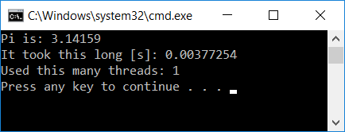
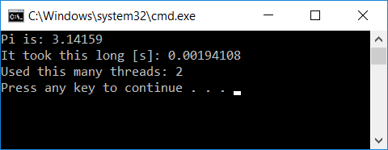
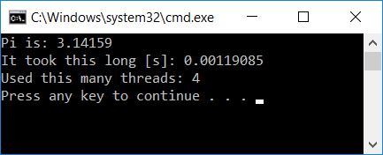
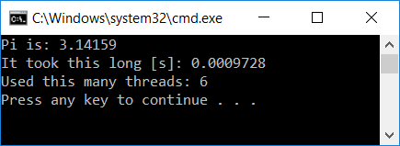
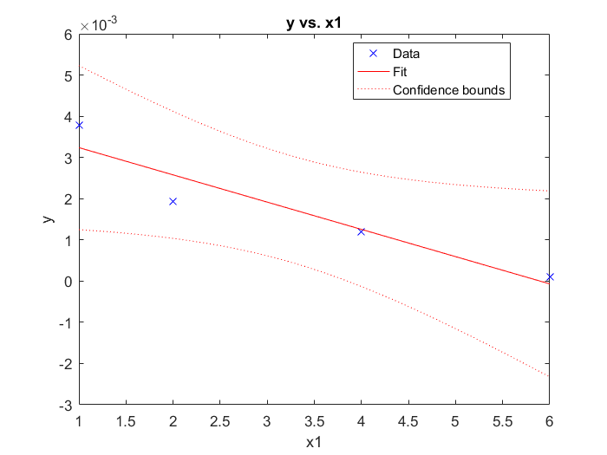
Scaling Analysis: Computation of $π$
#include <omp.h>
#include <stdio.h>
void main() {
static long num_steps = 1000000;
const double step = 1.0 / (double)num_steps;
double sum = 0.0;
double startT = omp_get_wtime();
const int nThreadsUsed = 1;
#pragma omp parallel num_threads(nThreadsUsed)
{
#pragma omp for reduction(+:sum)
for (int i = 0; i < num_steps; i++) {
double x = (i + 0.5)*step;
double dummy = 1. / (1. + x*x);
sum += dummy;
}
}
double myPi = 4.*step * sum;
double timeElapsed = omp_get_wtime() - startT;
printf("Pi is: %f\n", myPi);
printf("It took this long [s]: %f\n", timeElapsed);
printf("Used this many threads: %d\n", nThreadsUsed);
}

Slide 73
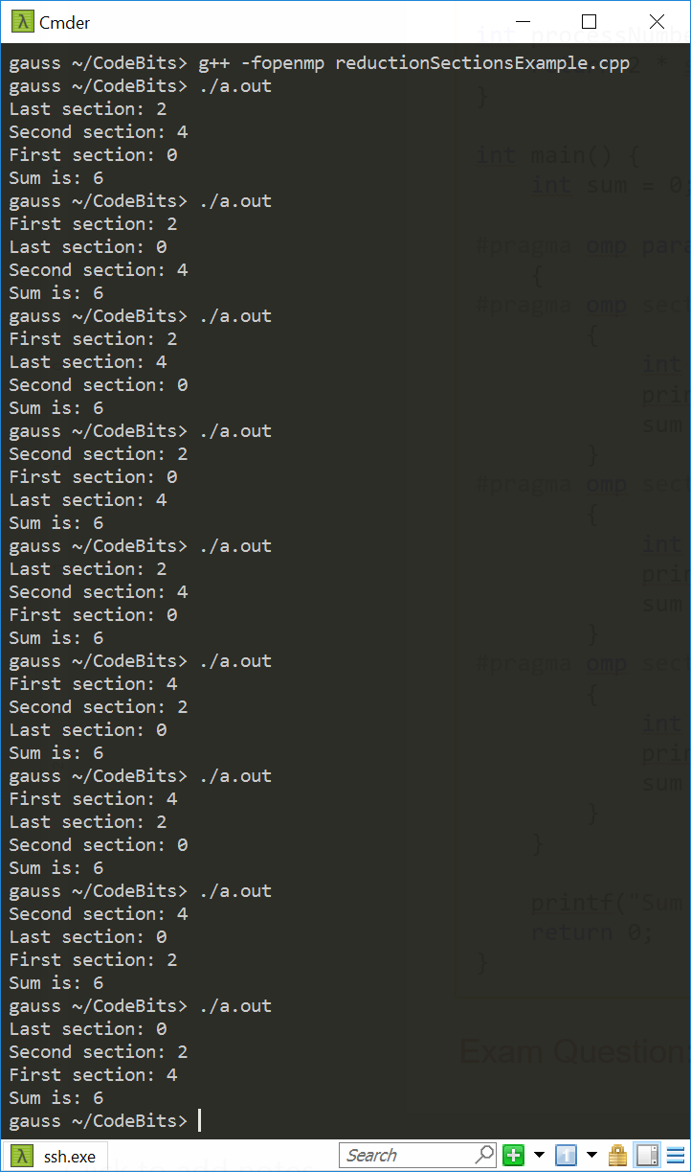
OpenMP reduction Works Beyond for Loops [1/2]
#include <stdio.h>
#include <omp.h>
int processNumber(int someNumber) {
return 2 * someNumber;
}
int main() {
int sum = 0;
#pragma omp parallel sections num_threads(3) reduction(+:sum)
{
#pragma omp section
{
int someVal = processNumber(omp_get_thread_num());
printf("First section: %d\n", someVal);
sum += someVal;
}
#pragma omp section
{
int someOtherVal = processNumber(omp_get_thread_num());
printf("Second section: %d\n", someOtherVal);
sum += someOtherVal;
}
#pragma omp section
{
int dummy = processNumber(omp_get_thread_num());
printf("Last section: %d\n", dummy);
sum += dummy;
}
}
printf("Sum is: %d\n", sum);
return 0;
}
NOTE: sum is always the same. What’s called “First section” is not necessarily executed by thread with smallest id.

Slide 74
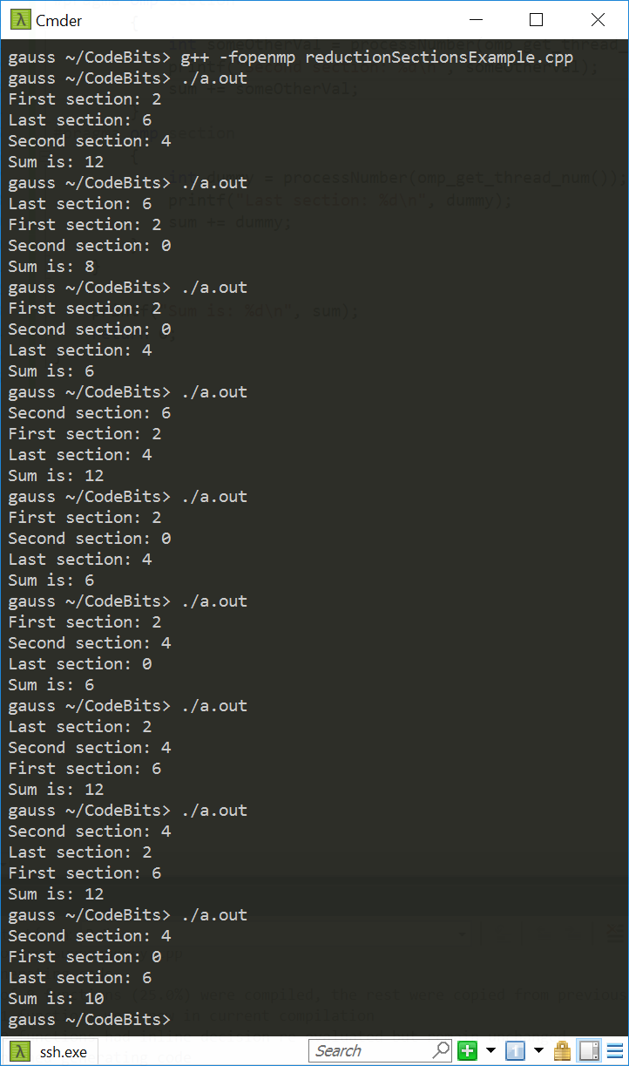
OpenMP reduction Works Beyond for Loops [2/2]
#include <stdio.h>
#include <omp.h>
int processNumber(int someNumber) {
return 2 * someNumber;
}
int main() {
int sum = 0;
#pragma omp parallel sections num_threads(4) reduction(+:sum)
{
#pragma omp section
{
int someVal = processNumber(omp_get_thread_num());
printf("First section: %d\n", someVal);
sum += someVal;
}
#pragma omp section
{
int someOtherVal = processNumber(omp_get_thread_num());
printf("Second section: %d\n", someOtherVal);
sum += someOtherVal;
}
#pragma omp section
{
int dummy = processNumber(omp_get_thread_num());
printf("Last section: %d\n", dummy);
sum += dummy;
}
}
printf("Sum is: %d\n", sum);
return 0;
}
Quiz: Why different sum values when we run this code?

Slide 75

A Histogram Example [more advanced, uses reduction w/ C++ STL]
int main(int argc, char *argv[]) {
// Set number of threads
const auto num_threads = std::atoi(argv[1]);
omp_set_num_threads(num_threads);
// Read in Image
FILE *fid = std::fopen("picture.inp", "r");
int d1 = 1800;
int d2 = 1200;
int len = d1 * d2;
std::vector<int> *image = read_image(fid, d1, d2);
// Histogram Counter
std::vector<int> histCounter = std::vector<int>(7);
// Declaration of the std::vector addition
#pragma omp declare reduction(vec_int_add : std::vector<int> : \
std::transform(omp_out.begin(), omp_out.end(), omp_in.begin(), omp_out.begin(), std::plus<int>())) \
initializer(omp_priv = omp_orig)
// Reset Histogram Counter to Zero
std::fill(histCounter.begin(), histCounter.end(), 0);
double startTime = omp_get_wtime(); // Start Clock
#pragma omp parallel for reduction(vec_int_add : histCounter)
// Perfrom the histrogram; shared(histCounter)
for (int jj = 0; jj < len; jj++)
(histCounter)[(*image)[jj]]++;
double endTime = omp_get_wtime(); // Stop Clock
// Ouput information
for (int ii = 0; ii < 7; ii++)
std::cout << (histCounter)[ii] << std::endl;
std::cout << num_threads << std::endl;
std::cout << std::setprecision(16) << (endTime - startTime) * 1000 << std::endl;
// delete(histCounter);
delete (image);
return 0;
}
#include <omp.h>
#include <algorithm>
#include <cmath>
#include <iomanip>
#include <iostream>
#include <vector>
// Read in vector of pixel vales
std::vector<int> *read_image(FILE *fp, int d1, int d2) {
int xVal;
int len = d1 * d2;
std::vector<int> *x = new std::vector<int>(len);
for (int i = 0; i < len; i++) {
fscanf(fp, "%d ", &xVal);
(*x)[i] = xVal;
}
return x;
}
[Christopher Van Damme]$→$

